Slide 1
Chapter 3 – Setting up your working environment
Artificial Intelligence

Slide 2
What will we be working with?
Progamming language: Python
IDE: Visual Studio Code
Integrated Development Environment
Use a virtual environment in Python
Use Jupyter Notebooks
Note: this is an active PowerPoint. You are supposed to follow along.

Slide 3
Python
There are a few alternatives to Python for data science:
Julia: Python, but you can compile it, so it’s faster. Good when Python becomes too slow, but not ideal to start with.
R: Used mainly by statisticians, who were the first data scientists. Feels strange at first but is a very powerful language to work with data (importing/cleaning/creating graphs). Preferred language to use in Business Intelligence tools.
We chose Python because it’s widely used.

Slide 4
Windows, Linux or MacOS?
Our examples and screenshots will always be made on Windows
And we know our code works on Windows
Because the teachers exclusively use Windows (for this course)
But the tools we use are all cross-platform
You can use MacOS or Linux
So we decided:
You’re free to use any OS you like
If you have any issues with your code we will help you figure out what’s going on
But we reserve the right to say “I can’t find the problem so it’s probably because you don’t use Windows. You figure it out.”
Notes:
Or you could install linux (without a gui) on a PC at home and leave it always on. Then buy the cheapest (or lightest) laptop you can find and install a tailscale tunnel on both the PC and the laptop. In class you always open a remote session from the laptop to the PC and work on the PC without noticing. This means you’ll have the raw processing power of a PC combined with a lightweight device. Win-win!

Slide 5
Installing Python
Go to https://www.python.org/downloads/
Download the latest version
DO NOT quickly click next through the installation!
Check the following slides

Slide 6
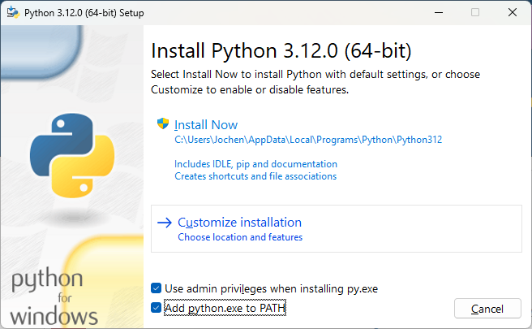
Installing Python
First screen:
“Add Python to path”
Click “Customize installation

Slide 7
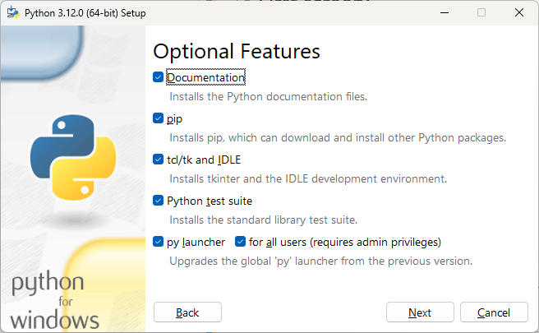
Installing Python
Leave the following screen as it is

Slide 8
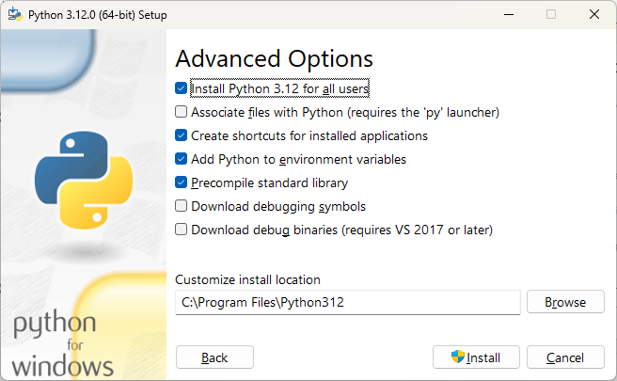
Installing Python
Select “Install Python for all users”

Slide 9
Visual Studio Code
Microsoft has had Visual Studio a long time
Since the nineties
Big, bulky program, only runs on Windows
But recently they released Visual Studio Code
Small and efficient
Open source
Works on any operating system
Can be used for any programming language (through plugins)
Integrates with github
Can be used on a remote system
We’ll be using the second one.
Notes:
https://www.youtube.com/watch?v=hilznKQij7A&list=PLj6YeMhvp2S6uB23beQaffszlavLq3lNq
https://vscode.dev/

Slide 10
Installing Visual Studio Code
Go to https://code.visualstudio.com/
Download the latest version for your operating system
Install using the default settings
Alternatives
Install using https://ninite.com/
Install as a portable app
Theoretically: use https://vscode.dev/

Slide 11
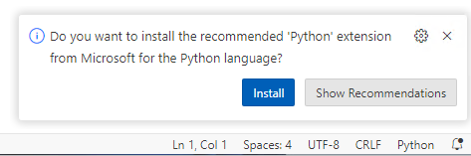
First time usage
When using VSCode for the first time, it will ask a lot
Default color scheme
Sync your settings
…
All of these can be changed later, so simply choose a nice color scheme and close the window
When starting a new type of file, there will be boxes on the lower right corner
Click “install”, it’ll make your life easier

Slide 12
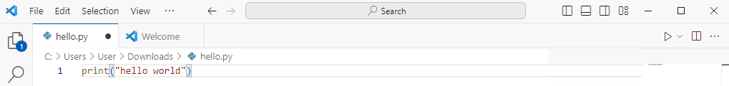
Opening a file
You can use VSCode as a text editor
You can open a file, edit it, and save it
If it’s code and you have the extension, you can run it
Although this works for some quick and dirty editing, it’s not the way you can get serious about developing

Slide 13
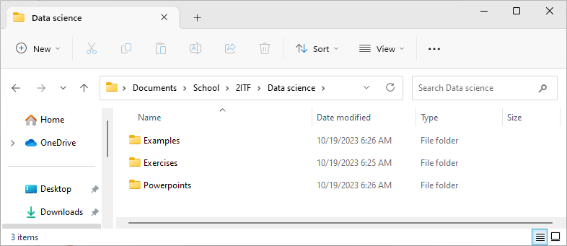
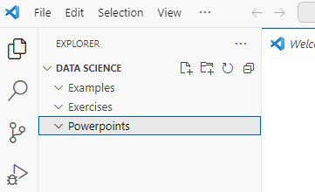
Opening a folder
Step 1: create a folder
You can decide which folder- structure to use, but we assume you have some sort of a system
Keep this folder on onedrive, or google drive, or dropbox, or a USB-stick, or…
Step 2: in VSCode, open this folder
Everything you do in these folders will also happen on your hard-drive
(Like create a subfolder per lesson, …)
If you close VSCode and reopen it, you’ll be back inside this folder

Slide 14
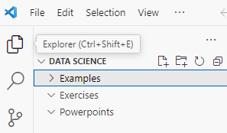
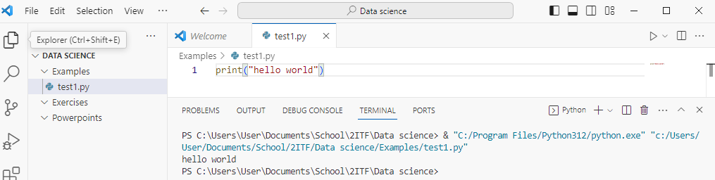
Creating a Python-script
Select a folder
Click the “Add file”-icon
Call the file “test_1.py”
Add Python code that prints “hello world”
Run the code using the little “play”-button in the upper right corner

Slide 15
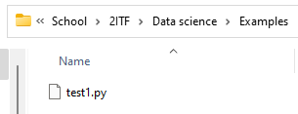
Creating a Python-script
The code runs in a terminal below
The file is also saved in your folder
When creating Python-scripts, this is the way to work

Slide 16
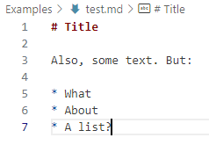
Using markdown files
Sometimes we’ll be using markdown files
Markdown is a way to style text using only simple markers, to help you write good looking text without using Word or HTML
In your example-folder, create a file and call it “test.md”
Add the following to the file

Slide 17
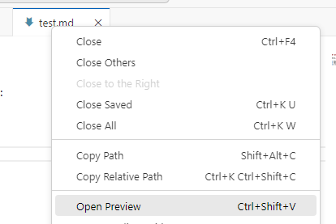
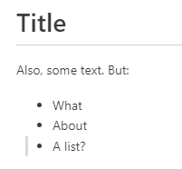
Using markdown files
Save the file and right-click the tab, choosing “Open preview”
The output will be the same file, but formatted
There are tags for adding code, images, links, …

Slide 18
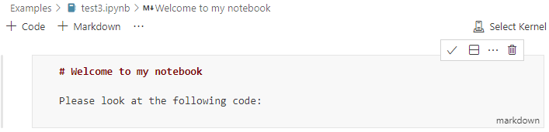
Using Jupyter notebooks
We did code and we did markdown, but can we combine them?
Yes! It’s called a Jupyter notebook
Create a new file called “test3.ipynb”
Add a markdown-cell and add some markdown-text
Click the checkmark on the top right to display formatted text
Double-click the formatted text to edit it again

Slide 19
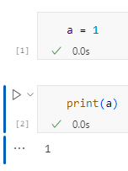
Using Jupyter notebooks
Create a couple of code-cells
In the first cell put “a = 1”
In the second cell put “print(a)”
Run both cells
If this is the first time you’re running Jupyter notebooks, VSCode will want to install a couple of things. Let them install.
Note how the variable you made in cell 1 still exists in the second cell
This is the big strength of Jupyter notebooks: you can try some code, create variables and based on the output of the code use the variables differently
Example: I imported this excel-file but the numbers are string. Better fix that before continuing.

Slide 20
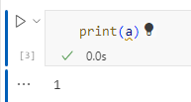
Using Jupyter notebooks
Delete the first cell
Now run the second cell again!
The print still works!
This is a pitfall: it’s not because you deleted a cell that the result of that cell is gone. The variables still exist and can still mess up your results.

Slide 21
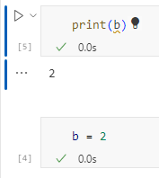
Using Jupyter notebooks
In the first cell put “print(b)”
In the second cell put “b = 2”
Run the second cell first and the first cell last
Works!
Another pitfall: when developing you move around the cells all the time. That is fine, but remember to always end up with a notebook that you can run top to bottom.
It’s impossible, or at least very frustrating, to recreate the order in which you ran cells earlier. Keep it clean and tidy.

Slide 22
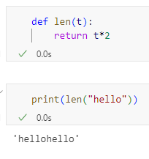

Using Jupyter notebooks
In the first cell overwrite the len-function
In the second cell, print the output of a len-function
Output checks out, but you just made the default len-function (length of a list or string) impossible to reach
Deleting the first cell won’t fix the problem (bad len-function is still in memory)
Solution: restart the kernel

Slide 23
Using Jupyter notebooks
When restarting all variables and functions are lost
You start over
If you are a particularly messy developer, restart your kernel by the end of the session
If you can still run all cells top to bottom, it’s fine
If you can’t anymore, something is wrong

Slide 24
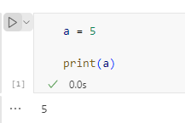
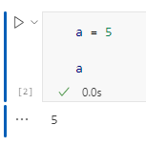
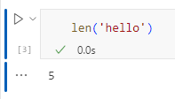
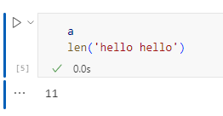
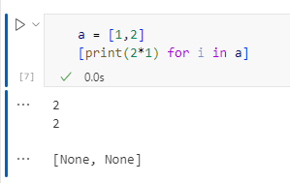
Using Jupyter notebooks
To print the contents of a variable, you can use print()
But notebooks also print the output of whatever the last statement in the code-block is
A variable
Output of a function
Not however
This only works with the last function
If the last function has no return-value, None is printed
Variable a isn’t printed!
This last row is the output of the list comprehension ->
Notes:
About the last example: It’s a list comprehension. You’ll be seeing more of these in the next chapter!
To avoid the row with “[None, None” use “dummy = [print(…”, so you’ll save the output and prevent it from printing.

Slide 25
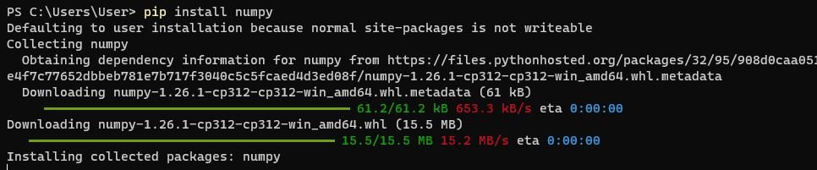
Libraries
When doing data science, you use a lot of libraries
Pandas, matplotlib, numpy, seaborn, …
These libraries are open source packages of code that have been written and that we can use on our own system
You can install them using pip: (Do not do this on your own system yet!)

Slide 26
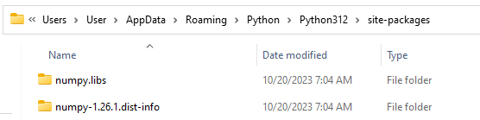
Libraries
But the problem?
We just installed numpy on our system. This means that numpy will be available on every python-session we use, and that is not a best practice.
A rule of thumb: never install packages on your system, install them in a virtual environment
And another rule of thumb: create a new virtual environment for every new project you start
Notes:
The reason is mainly versions. Suppose we have a notebook now that works with numpy version X. We upgrade our local python installation, install numpy version Y and all of a sudden our notebook doesn’t work anymore! If version X had been installed in a virtual environment that would not have been a problem.

Slide 27
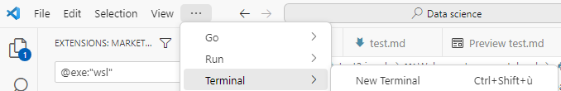

Virtual environments
(This you can do)
Open VSCode and select “New terminal” on top
In the terminal, type:
Note: these are two separate commands, to be run on two different lines
The terminal changes to
Notes:
When PowerShell won’t execute the activate-script, run:
Set-ExecutionPolicy remotesigned -scope currentuser

Slide 28
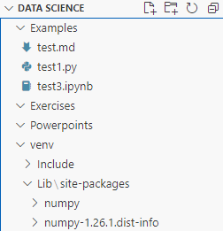

Virtual environments
Every library you now install ends up in the venv-subfolder:
And that is where they belong, nice and close to the code that is using them

Slide 29

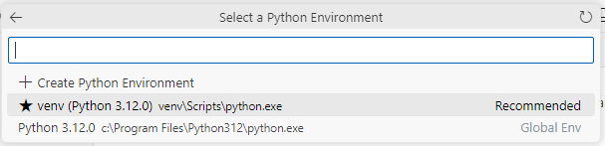
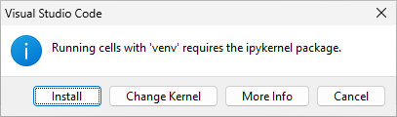
Venv in Jupyter notebooks
Once you have created a virtual environment it will be suggested as a ‘kernel’
Open ‘test3.ipynb’
Check the current
kernel in the top right
Click the current kernel to select a new one
After some clicking on the top of VSCode you can select it
(Also install the ipykernel package when asked to do so)

Slide 30
Venv in Jupyter notebooks
Everytime you open a new notebook it will ask you which kernel to use
Always select the venv you just made, never the default Python installation
Nice to know: want a venv in an older version of Python?
Install the older version of Python, but don’t let it register in the path
Create the new venv using the full path to the new (old version of) Python
That venv will from now on always use the old Python

Slide 31
Filling a venv
We’ll be using quite a lot of libraries in this course
You can install new libraries using “pip install …”
And you can run this in a code cell by saying “!pip install …”
And you can freeze an environment by using “pip freeze”
All information in the notebook called “1 - Working with a venv.ipynb”
In the exercises-folder
Run it now!

Slide 32

Venv in github
Finally, suppose you are working with a venv in a folder that is synced with github, do you want to upload your venv to github?
No.
You do want to run a pip freeze every now and then and upload the requirements file
To prevent uploading the venv to github:

Slide 33
Debugging
https://code.visualstudio.com/docs/datascience/jupyter-notebooks
Read the above article. It will speed up your development enormously.

Slide 34
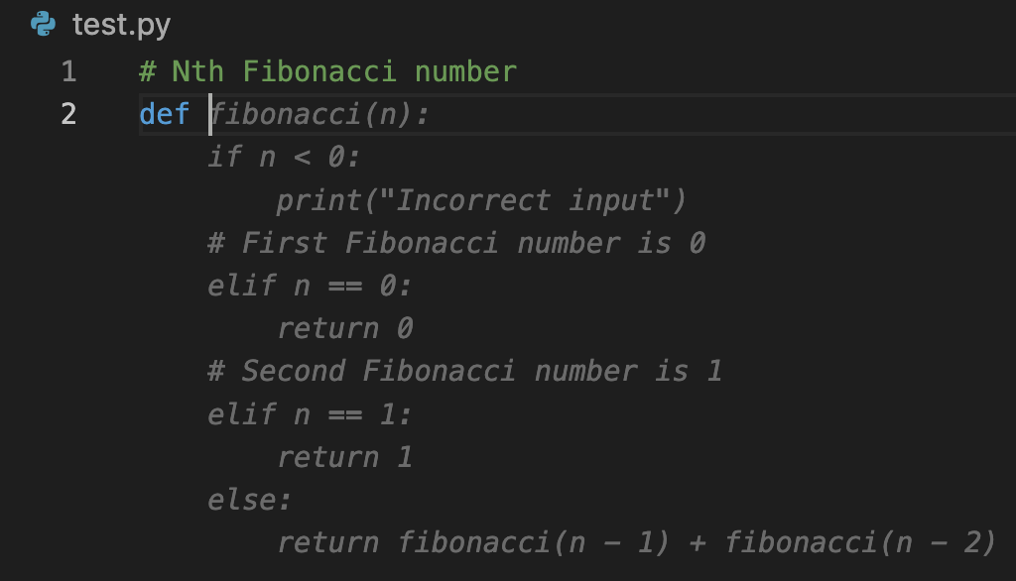
Copilot and Codeium
Copilot and Codeium are two VSCode-plugins that will help you write code
Basically, when you write a comment they look it up for you in Google and paste the code they found
They are great tools that you should be using

Slide 35
Multiline cursor
Ever needed to do the same thing on multiple lines?
Multicursor editing!

Slide 36
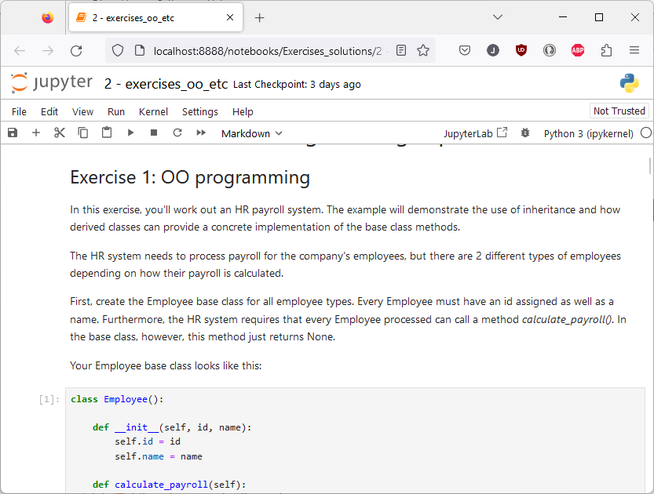
Jupyter in your browser
Tired of looking at the same VSCode interface?
Try Jupyter in your browser!
‘pip install jupyter’
‘jupyter notebook’
Note: during class we prefer normal VSCode, but this is too cool not to show…

Slide 37
Summary
Setting up an IDE is always the first step when starting a new programming language
It takes some time, but is worth doing right
You may want to start out using a simple editor when trying a new language, but a good IDE will always help you work better in the long run
After going through these slides you’ll have a working setup
Try “3.1 – working with a venv.ipynb” now!

Slide 38
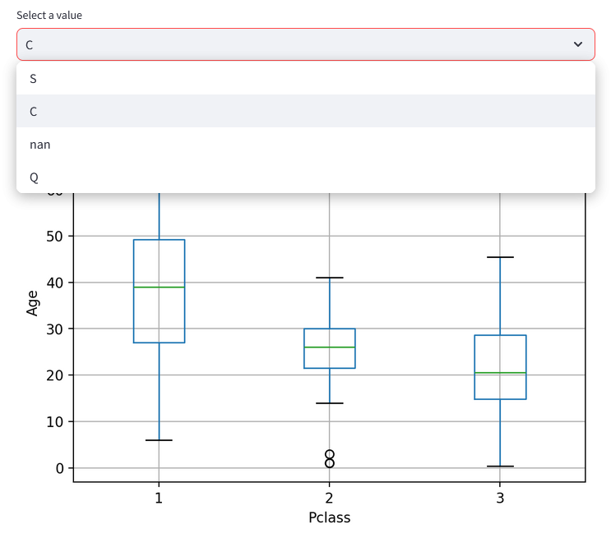
Addendum: Streamlit
Jupyter is great for a data scientist who knows how to run data, but it doesn’t present very well
It’s also not ideal for interaction: to change the input you have to tinker with variables
Streamlit fixes this, it creates a webpage based on python code that dynamically generates graphs from the input parameters

Slide 39
Streamlit
Give it a spin:
https://streamlit.io/playground
(Trying it out without having even installed Python)
Install using “pip install streamlit”
In a venv!
Run using “streamlit hello”
Next, go through the notebook called “3.2 - Streamlit 101.ipynb”
It builds the graphs we’ll be putting in the streamlit app
And finally build (and understand, as you’ll have to build the next one yourself) file 3.3.

